Slide 1
Student Affairs Key Performance

Slide 2
Disruption
Large turnover in leadership
Outside agency brought in to review and make recommendations
Division does not currently have well defined understanding of which of their key performance measures contribute to student success.

Slide 3
Key performance Measures
Sense of Belonging
Level of University Engagement
Thoughts of Leaving School
Resiliency
Satisfaction

Slide 4
Proposed Outcome
Academic Success
Retention
2nd semester
Ongoing
Graduation
Any
4 year

Slide 5
Data Sources
Student Information System
Retention Table
Census Data
OrgSync – Campus Involvement
Student Experience Survey – 2 years

Slide 6
2017 Student Life Survey
Implemented April of 2017
1,247 Responses from 7,000 randomly sampled students
5,000 Undergraduates (N = 877)
2,000 Graduates (N = 370)
18% Overall Response Rate
17.5% Undergraduate
18.5% Graduate
Notes:
Note – confidential study

Slide 7
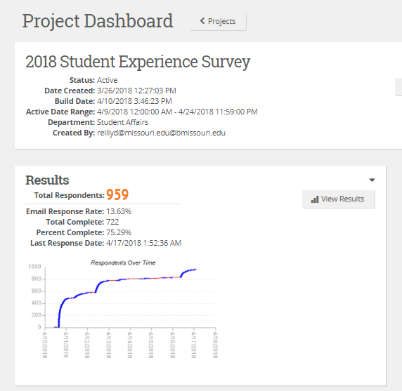

Slide 8
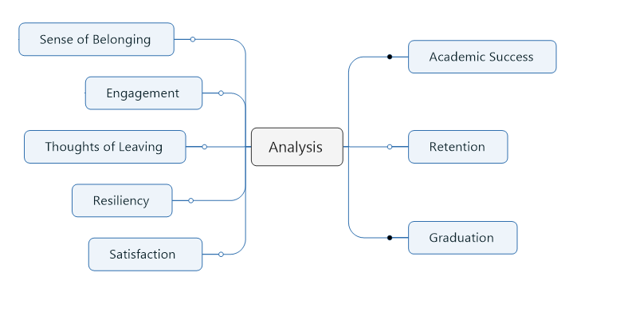

Slide 9
Sense of Belonging
66%
Agree or Strongly Agree

Slide 10
Sense of Belonging
All | 66%
Undergrad | 71%
Grad | 54%
Female | 69%
Male | 64%

Slide 11
Sense of Belonging
Advising Group
Missing | 55%
1 | 75%
2 | 76%
3 | 74%
4 | 71%

Slide 12
Level of Engagement
Undergraduate Students
Not Engaged | 14%
Engaged | 57%
Highly Engaged | 29%
Notes:
Not Engaged
Engaged
High Engagement
More than attending
In more than one thing

Slide 13
Involvement Frequency

Slide 14
Engagement and Outcomes (UG)
 | Not Engaged | Engaged | High Engaged
Thought of Transferring | 33% | 30% | 22%
Thought of Discontinuing College | 22% | 14% | 10%
Satisfaction with Education | 0.9 | 1.1 | 1.2
Satisfaction with out of classroom experience | 0.6 | 1.0 | 1.4
Sense of Belonging - Member of community | 0.1 | 1.0 | 1.4
Sense of Belonging - Sense of belonging | 0.1 | 0.8 | 1.2
Resiliency - Able to adapt to change | 3.0 | 3.2 | 3.3
Resiliency - Tend to bounce back after hardship | 3.0 | 3.2 | 3.4
Learning outcomes - Make difference on campus | -0.6 | 0.3 | 1.0
Learning outcomes - Met individuals with different interests | 1.1 | 1.4 | 1.7
Learning outcomes - Met individuals with similar interests | 1.0 | 1.4 | 1.7
Drinking - Number of drinks when typically drink | 3.0 | 3.5 | 3.4
Stress - Level of stress in past two weeks | 3.0 | 3.0 | 3.0
GPA (SIS data) | 3.09 | 3.21 | 3.33

Slide 15
Thought of Transferring from Mizzou
All | 22%
Undergrad | 28%
Grad | 11%
Male | 22%
Female | 24%

Slide 16
Satisfaction

